Slide 1
Lesson 2: Building a robot that navigates well
Seshan brothers

Slide 2
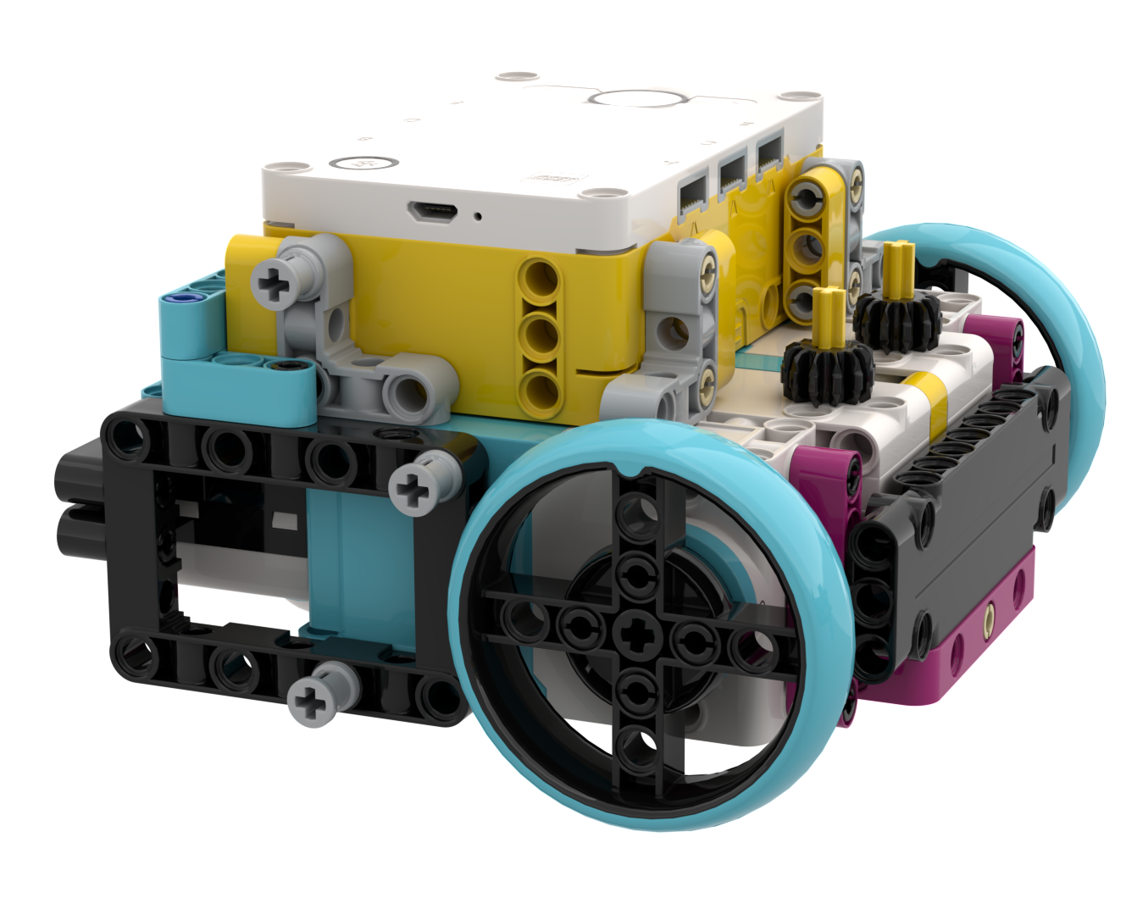
What features do you need
To navigate well, you will need a robot with features that allow you to navigate well

Slide 3
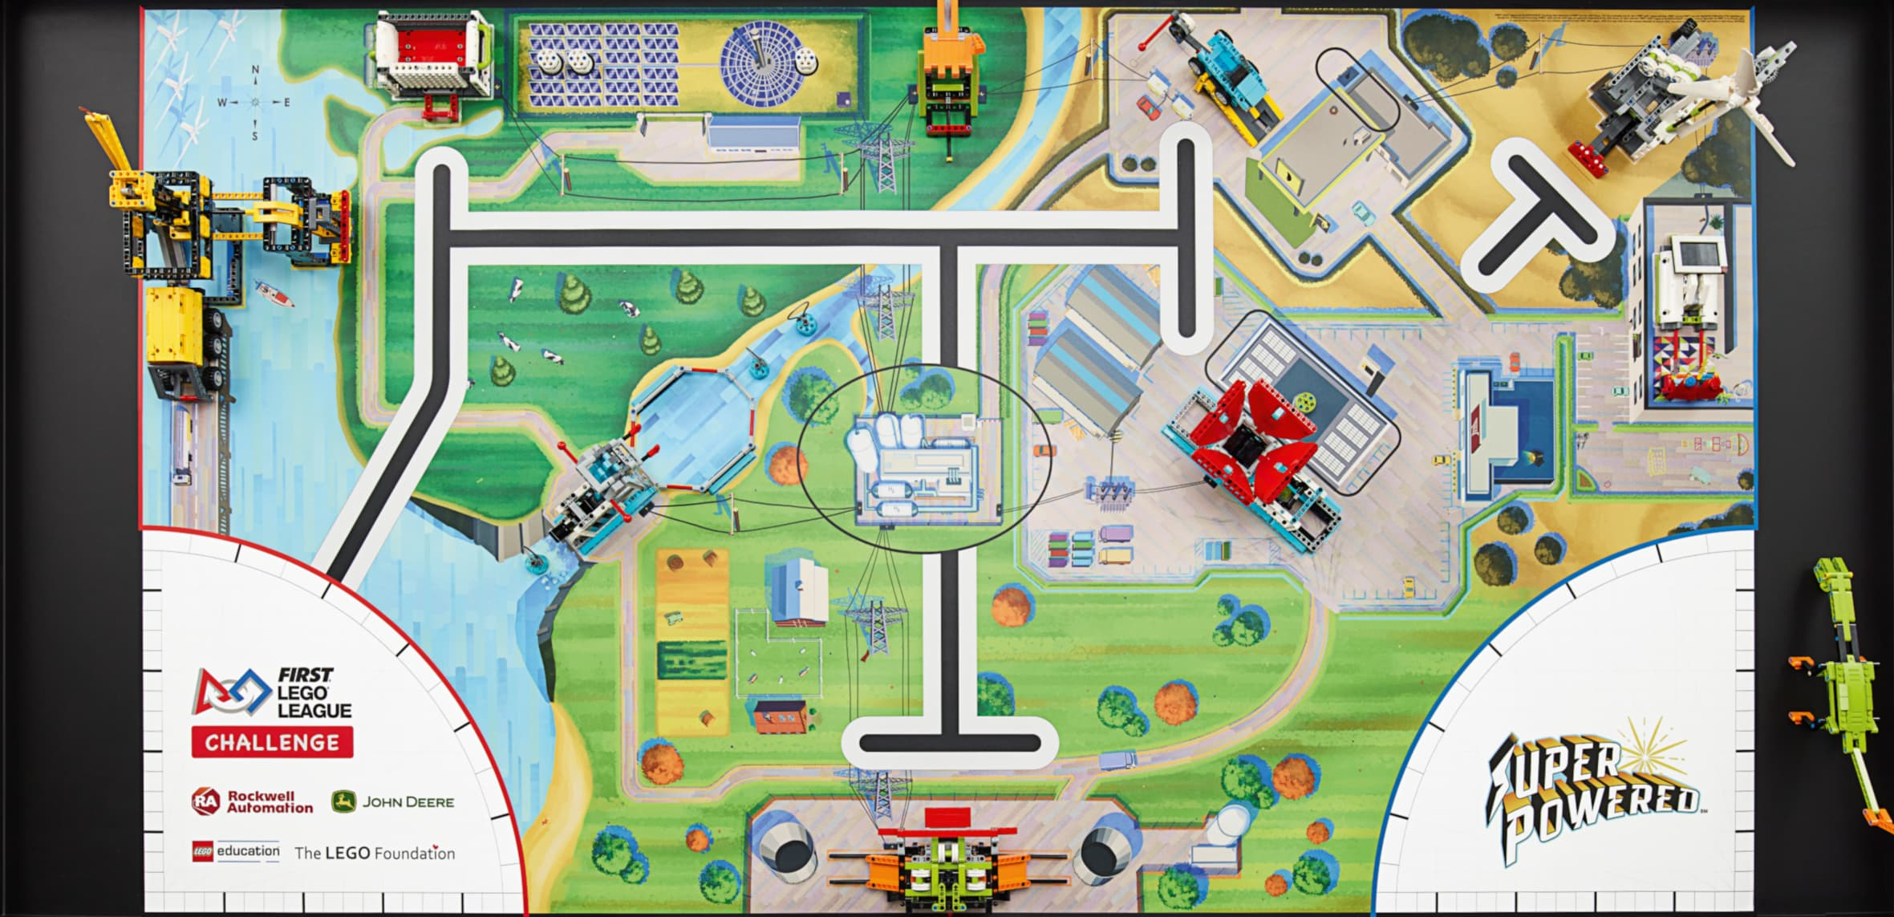
Navigating reliably in FIRST LEGO League
Good navigation will use some or all of these techniques
Move straight for a distance
Turning robot by degrees
Aligning in Launch
Wall follow
Aligning on lines
Aligning on walls
Aligning on mission models
Line following
Each of these techniques requires that your robot design to have specific features

Slide 4
SOME Key Robot Features
Outer walls
Makes it possible to align on flat surfaces (walls and mission models)
Keeps wheels well supported → improves accuracy of moving straight and turns
Two color sensors that are aligned but separated by some distance
Makes it possible to align on lines
Color sensors that are “in front” of the drive wheels
Makes it possible to line follow
Wall-riding wheels
The quality of the walls in contests can vary greatly (different textures, wood knots, holes, etc.). Wheels improves the ability to wall follow and align on walls
While every team’s robot should be different, most successful designs have the above features

Slide 5
Droidbot Model C
This robot has the key features for good navigation
** Shielding of color sensors is not needed in practice. See lesson on color sensor placement.
Low center of gravity
Two well-separated, aligned color sensors
Outer walls that support wheels
Wall riding wheels
Level construction – notice caster is level with drive wheels
Color sensors well in front of driving wheels

Slide 6
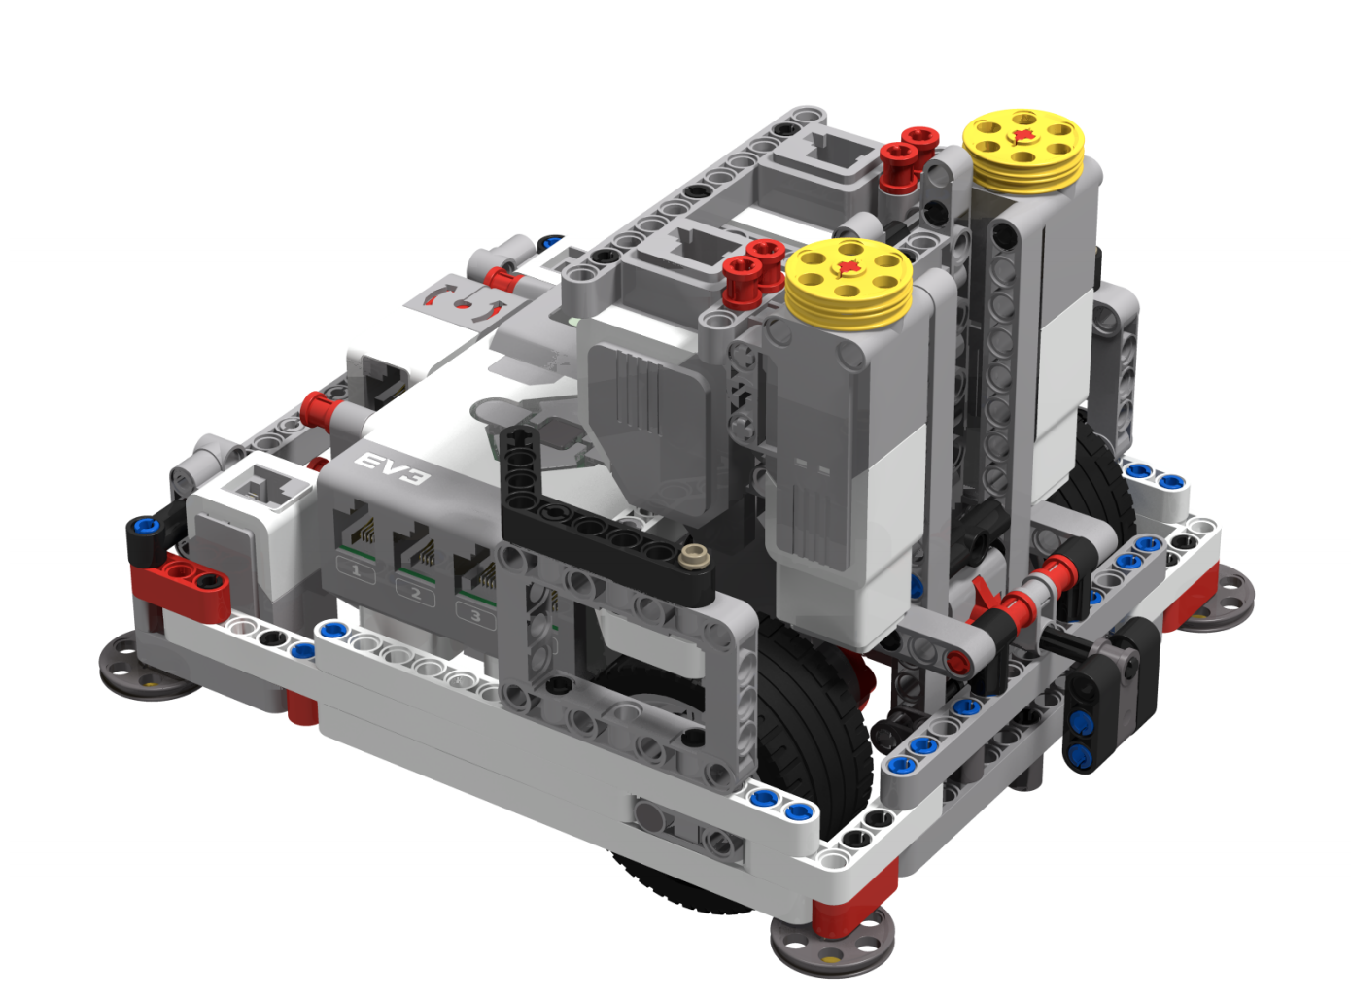
Additional features to consider
Quick, inter-changeable attachments that let you complete missions on many sides of the robot
Adding the attachment should not cause weight distribution issues on the robot
Can be made with minimal parts – DroidBot Model C is made with a single kit plus just 2 additional parts
Pulley wheels added to motors for easy attachments
Pulley wheels and pegs on attachment connect quickly to motors on the robot. This attachment slides into DroidBot Model C.

Slide 7
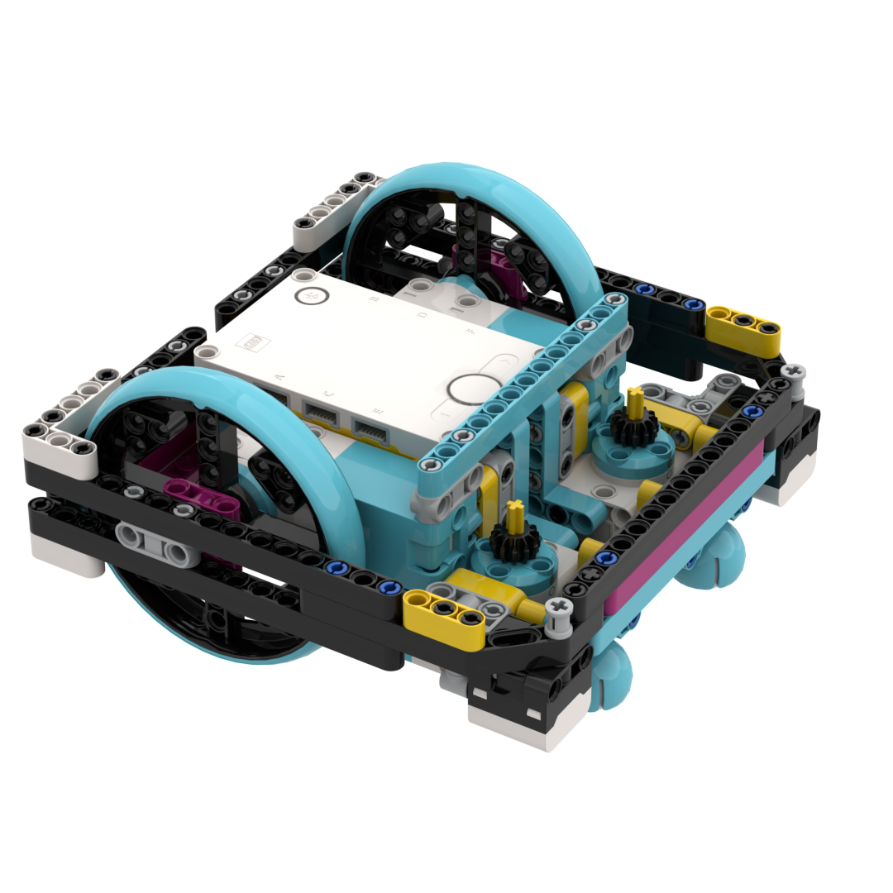
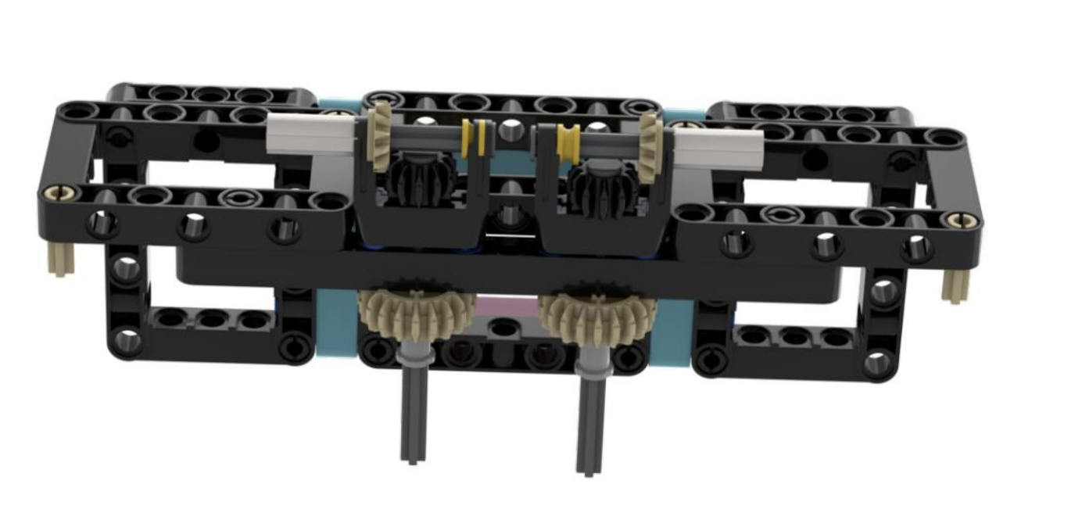
SIMILAR FEATURES ON DROID BOT E

Slide 8
What’s next
As you build your team’s robot, take these features into consideration
There are some alternative designs available on FLLTutorials.com, PrimeLessons.org and EV3Lessons.com that you can try and learn from

Slide 9

Credits
This tutorial was created by Sanjay Seshan and Arvind Seshan
More lessons at www.ev3lessons.com and www.flltutorials.com
This work is licensed under a Creative Commons Attribution-NonCommercial-ShareAlike 4.0 International License.

